Slide 1
Weapon Detection from Body- Cam

Slide 2
Motivation
Detect weapons from body-worn cameras for military and public safety applications
  Real-time alerts during active operations
  Enhanced situational awareness
  Indexed recordings for efficient post-event analysis

Slide 3
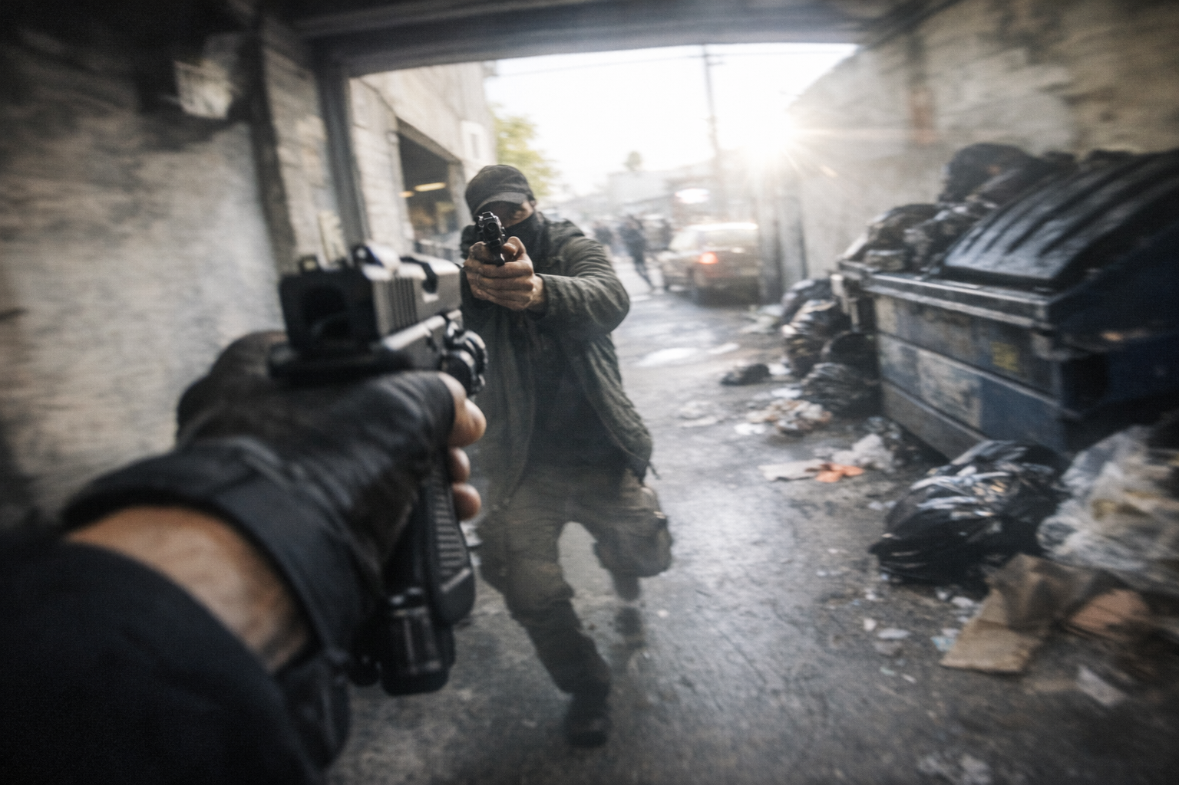
Weapon detection: Novelty
Dataset | Modality
Weapon Detection CCTV v3 – CCTV-oriented images (weapon classes) | Images / CCTV-style
Weapon Detection (Kaggle) – multi-class weapons | Images
Weapon Detection (alternate Kaggle) – general weapon images | Images
Pistols Object Detection (Roboflow) | Images
Weapons in Images Dataset | Images + some CCTV frames
Gun/Kits Combined (CCTV-video oriented) | Video frames
UCF Crime (frames) – general surveillance crime | Video frames
Firearm-Action & Detection (Mendeley) | Surveillance video
Monash Gun / USRT / UCF subsets (from GitHub repo example) | Images (various)
In surveillance footage and general images
  Many datasets exist (table)
In first-person video: new challenges
  Strong motion blur from rapid body movement.
  Extreme viewpoint changes and unusual angles
  Very short and partial visibility of weapons
  Highly dynamic, cluttered scenes
  Rapidly changing lighting conditions
No labeled training/evaluation dataset exists for body-cam weapon detection
  Create synthetically using Generative models

Slide 4
Datasets Requirements
Labeled realistic body-cam images
  An image and a bounding box(ground truth label) for object detection
Alternatives for Synthetic data generation
  Augment existing dataset: introduce distortions to existing surveillance images with already labeled weapons
  Inpainting: use existing FPV footage and in-paint weapons into target locations
  Generating from scratch/distillation: generate or augment body-cam images with a weapon, use a strong model (SAM) to label/detect weapons

Slide 5
ML Task Definition
Input
  An image: a single frame from a body cam with appropriate resolution
  Include realistic distortions: blur, partial occlusion, imperfect light, cluttered scene
Output
  A list of bounding boxes for all weapons
  Optionally, type of weapon (knife, handgun, etc.)
KPIs/Metrics
  Object detection metrics: mAP@0.5 and mAP@0.5:0.95
  Classification metrics: accuracy
  Mission-critical task: increase the importance of false negatives

Slide 6
Models
Baseline
  Pretrained object-detection models with “gun” or “knife” classes
  Pretrained on surveillance or general images (Open Images (V6 / V7)
  Lower bound of model performance
Fine-tuned models
  Fine-tune using synthetic data
  Several versions of YOLO
  RT-DETR
As a gold standard
  The best possible case, upper bound of model performance
  SAM or Grounding Dino
  Heavy model that can’t run in real-time over a mobile camera
Model | mAP @0.5 | mAP @0.5-0.95 | Class Accuracy | False Negatives
YOLO OI (lower bound) | xx | xx | xx | xx
YOLO FT | xx | xx | xx | xx
DETR FT | xx | xx | xx | xx
SAM (upper bound) | xx | xx | xx | xx
Expected Results

